Slide 1
BT201
Biochemical Process Calculations
07/09/2022

Slide 2
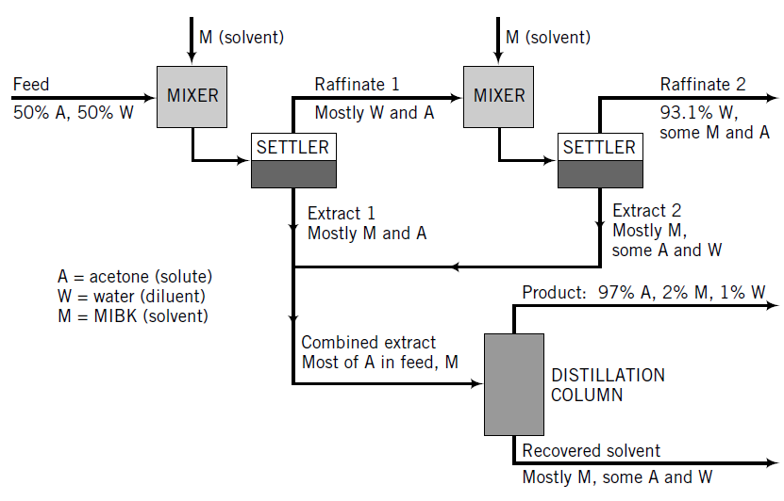
Extraction-distillation units
A mixture containing 50.0 wt% acetone (A) and 50.0 wt% water (W) is to be separated into two streams—one enriched in acetone, the other in water.
The separation process consists of extraction of the acetone from the water into methyl isobutyl ketone (MIBK), which dissolves acetone but is nearly immiscible with water.

Slide 3
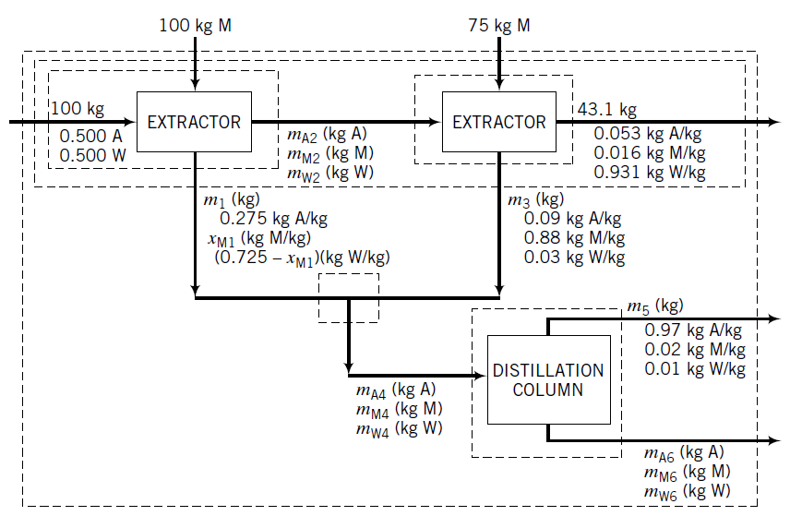
In a pilot–plant study, for every 100 kg of acetone–water fed to the first extraction stage, 100 kg of MIBK is fed to the first stage and 75 kg is fed to the second stage.
The extract from the first stage is found to contain 27.5 wt% acetone.
The second-stage raffinate has a mass of 43.1 kg and contains 5.3% acetone, 1.6% MIBK, and 93.1% water, and
the second-stage extract contains 9.0% acetone, 88.0% MIBK, and 3.0% water.
The overhead product from the distillation column contains 2.0% MIBK, 1.0% water, and the balance acetone.

Slide 4
Taking a basis of calculation of 100 kg acetone–water feed,
Calculate the masses and compositions (component weight percentages) of the Stage 1 raffinate and extract,
Calculate the masses of the Stage 2 extract and the combined extract,
Calculate the masses and compositions of distillation overhead and bottoms products.
Can you solve it? Can you solve it if there were no water in the overhead product from the distillation column?

Slide 5
Check how degree-of-freedom analysis allows a fairly quick determination of which variables can be determined and how to determine them efficiently, and also helps avoid wasting a great deal of time trying to solve a problem with insufficient information.
Begin by drawing and labeling the flowchart. For simplicity, treat each mixer–settler combination as a single “extractor” unit.

Slide 6
Degree of freedom analysis
Balances may be written for any of the systems shown on the chart, including
overall process,
individual extractors,
two-extractor combination,
point where the two extract streams combine, and
distillation column.
Degree-of-freedom analysis for the overall process
A degree-of-freedom analysis for the overall process indicates that there are four unknown variables
and only three equations that relate them (one material balance for each of the three independent species involved in the process), leaving one degree of freedom.

Slide 7
Degree-of-freedom analysis for the other sysems
Similarly, the first extractor has two degrees of freedom (5 unknown - 3 balances = 2 dof)
second extractor has one degrees of freedom (4 unknown – 3 balances = 1 dof) ,
the extract mixing point has three degrees of freedom ( 6 unknown - 3 balances = 3 dof) ,and
the distillation column has four degrees of freedom (7 unknown - 3 balances = 4dof) .
However, the system composed of the two extraction units involves only three unknowns (m₁, x_{M1}, m₃) and three balances relating them, hence zero degrees of freedom.

Slide 8
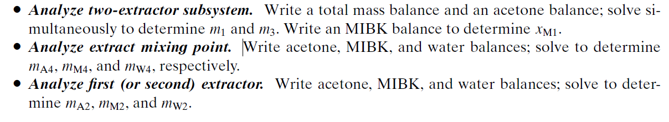
The solution procedure is as follows

Slide 9
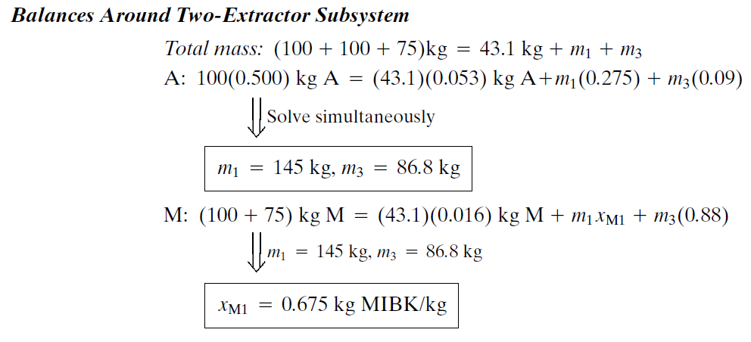

Slide 10

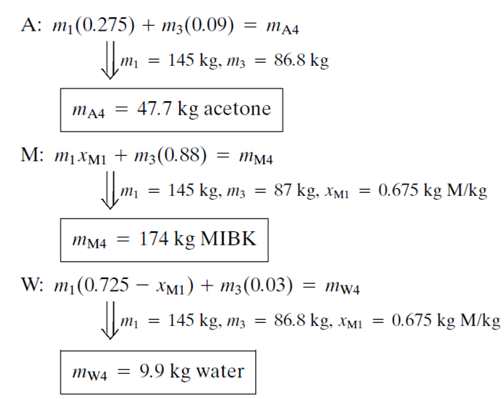

Slide 11
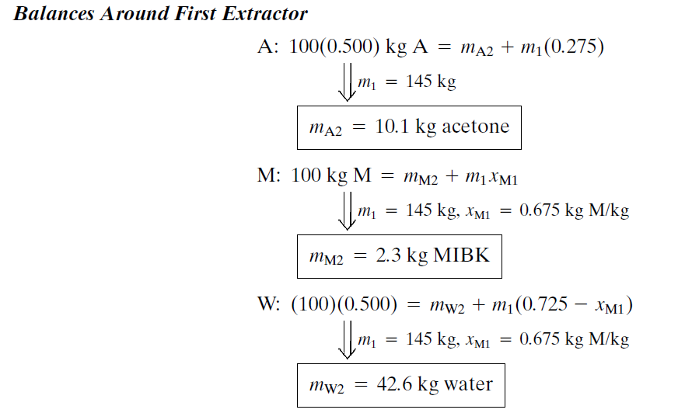

Slide 12

There are four remaining unknowns
Whether we choose the overall process or the distillation column as our system, we will only have three independent equations and hence one degree of freedom, and so we will be unable to solve the problem.
Since acetone, MIBK, and water all appear in both outlet streams, we cannot solve for any one of the individual unknowns
Need one more independent relation/information
The problem is thus underspecified; unless another piece of information is furnished,
the amounts and compositions of the distillation column products are indeterminate.

Slide 13
Analysis of a Sugar Recovery Process Involving Multiple Serial Units
Figure shows the process and the known data. Calculate the compositions of every flow stream, and the fraction of the sugar in the cane (F) that is recovered in M.
The process is an open, steady-state system without reaction.
What basis should you pick?
What system should you pick to start the analysis?
15% Sugar
No pulp

Slide 14
Degree of freedom analysis
For overall system: DOF>0
Can not start with overall material balance
15% Sugar
No pulp

Slide 15
Degree of freedom analysis
Check with single unit
Crystallizer: (Flow rate is given: M: 1000 Ib/hr)
2 Unknown: K, L (% water in K and L are known)
2 balances
DOF=0
15% Sugar
No pulp

Slide 16
Crystallizer:
L stream: only water
M stream have only sugar and no water
K: 40% sugar, 60% water
Overall balance: K=L+M=L+1000
Sugar balance: 0.4*K=M*1+L*0
K=2500
L=1500
Evaporator:
J stream: only water
H stream have sugar (15%) and water (85%)
Overall balance: H=K+J=2500+J
Sugar balance: 0.15*H=0.4*K+J*0
H=6667
J=4167
15% Sugar
No pulp

Slide 17
SCREEN:
E stream: sugar (13%), water (73%) and pulp (14%)
H stream: sugar (15%), water (85%) and pulp (0)
G stream: sugar, water and pulp (95%)
H: flow rate known
DOF=??
Unknown:3 (G, E, % of sugar or pulp in G)
balances:3
DOF=0
Overall balance: E = G+H = G+6667
Sugar balance: 0.13*E = 0.15*H + fraction of sugar in G*G
Pulp balance: 0.14*E = 0*H + 0.95*G
E=7819 Ib/hr
G=1152 Ib/hr
fraction of sugar in G=0.014
fraction of water in G=0.036
15% Sugar
No pulp

Slide 18
MILL:
E stream: sugar (13%), water (73%) and pulp (14%)
F stream: sugar (16%), water (25%) and pulp (59%)
D stream: sugar (??), water (??) and pulp (80%)
Unknown flow rate: D, F
DOF=??
Unknown:3 (D, F, % of sugar or water in D)
balances:3
DOF=0
Overall balance: F = D+E = D+7819
Sugar balance: 0.16*F = 0.13*E + fraction of sugar in D*D
Pulp balance: 0.59*F = 0.14*E + 0.80*D
F=24574 Ib/hr
D=16755 Ib/hr
% of sugar in D=17.4
% of water in D= 2.6
15% Sugar
No pulp

